Slide 1
DATA VISUALIZATION FOR WATER QUALITY ANALYSIS
CSE 2026_DHV
Review-1
8ISE2
Roll Number | Student Name
20201ISE0061 | Shiva Kumar P
20201ISE0087 | Aman D Shet
20201ISE0095 | Hemanth Kumar D M
Ms. Poornima S Ast.Professor
School of Computer Science & Engineering
Presidency University

Slide 2
Abstract
This report explores the application of data visualization techniques to the Water Quality Analysis dataset, aiming to transform raw data into actionable insights. Utilizing Python's data manipulation and visualization libraries—Pandas and Matplotlib—we present a series of visualizations that highlight the key data analysis of data. Utilizing exploratory data analysis (EDA) techniques, we visualize trends over time, identifying seasonal patterns and fluctuations across different categories. The analysis identifies significant contaminants and potential sources of pollution, correlating these findings with nearby industrial, agricultural, and urban activities. The study further assesses the potential impacts of these contaminants on human health and aquatic ecosystems, providing a comprehensive risk assessment.
Based on the findings, the study offers targeted recommendations for improving water quality, including specific remediation strategies and ongoing monitoring protocols. This research not only informs local and regional water management practices but also contributes to broader efforts to ensure the sustainability and safety of vital water resources.

Slide 3
Introduction
This report provides a comprehensive analysis of Water Quality Analysis using data visualization techniques. By leveraging Python's data manipulation and visualization libraries—Pandas, Matplotlib, and Seaborn—we present clear and insightful visualizations of Water Quality Analysis and encompasses the quality of water in rivers, lakes, reservoirs, and groundwater systems is influenced by natural processes and human activities.
The methodology for this water quality analysis includes systematic sampling, rigorous laboratory analysis, and robust data interpretation. Samples will be collected using standardized procedures to ensure accuracy and consistency. Advanced analytical techniques will be employed to measure the selected parameters, followed by statistical and spatial analysis to interpret the data. This approach ensures a thorough and reliable assessment of the water quality.

Slide 4
Libraries
pandas (pd): Powerful tool for working with data tables, like spreadsheets. You can analyze, clean, and manipulate data easily.
matplotlib.pyplot (plt): Lets you create charts and graphs to visualize your data. Think colorful pictures that tell stories from numbers.
seaborn (sns): Built on top of matplotlib, seaborn makes creating attractive and informative visualizations even easier. It's like having a designer for your data charts.

Slide 5
Advantages of existing methods:
Enhanced Understanding: Visualizations convert complex data into understandable graphics, making it easier for viewers to grasp insights and trends.
Better Decision-Making: By presenting data in a visually compelling way, these techniques aid stakeholders in making informed decisions based on clear evidence.
Engagement: Visualizations are more engaging than raw data, capturing the audience's attention and facilitating deeper exploration of the data.
Communication: They improve communication of findings, making it easier to share and explain results with diverse audiences, including those without technical backgrounds.
User-Friendly: Data visualizations are often more accessible to a wider audience, including those without advanced analytical skills. They allow non-experts to understand complex datasets through intuitive graphics.
Interactivity: Many visualization tools offer interactive elements, such as zooming, filtering, and clicking to reveal more details. This interactivity makes data exploration more engaging and informative.

Slide 6
Proposed Method cont.
Tools and Libraries:
Utilized Pandas for data manipulation.
Employed Matplotlib and Seaborn for creating visualizations.
Objective:
Provided clear, insightful visualizations to understand trends, make comparisons, and visualize the pandemic's impact, aiding in informed decision-making.

Slide 7
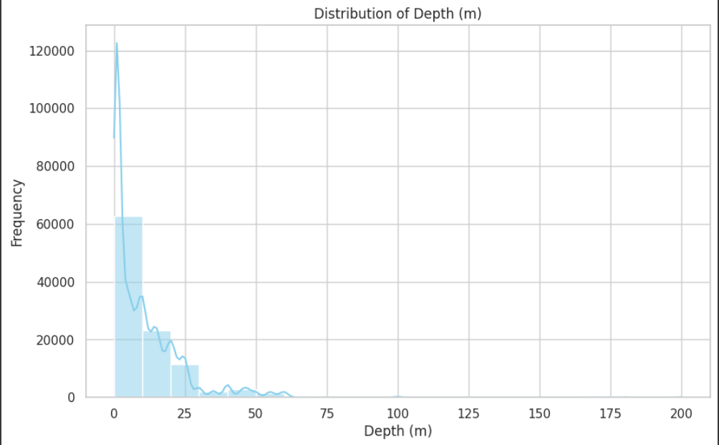
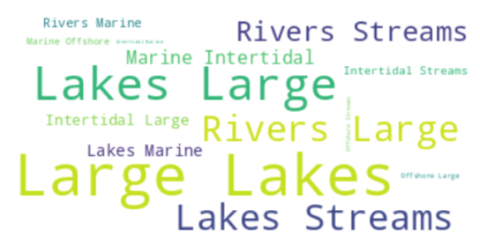
Result

Slide 8
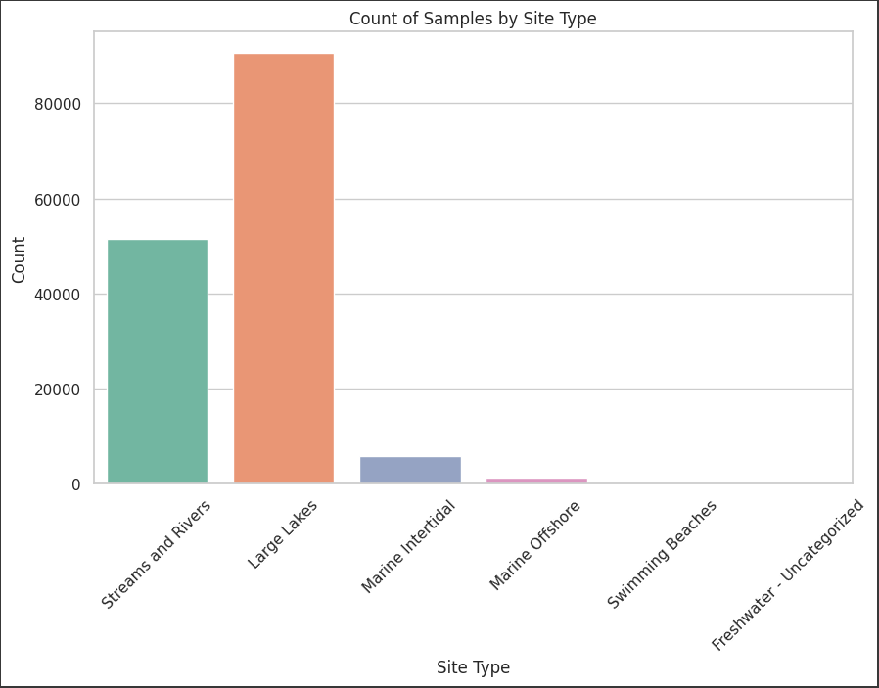
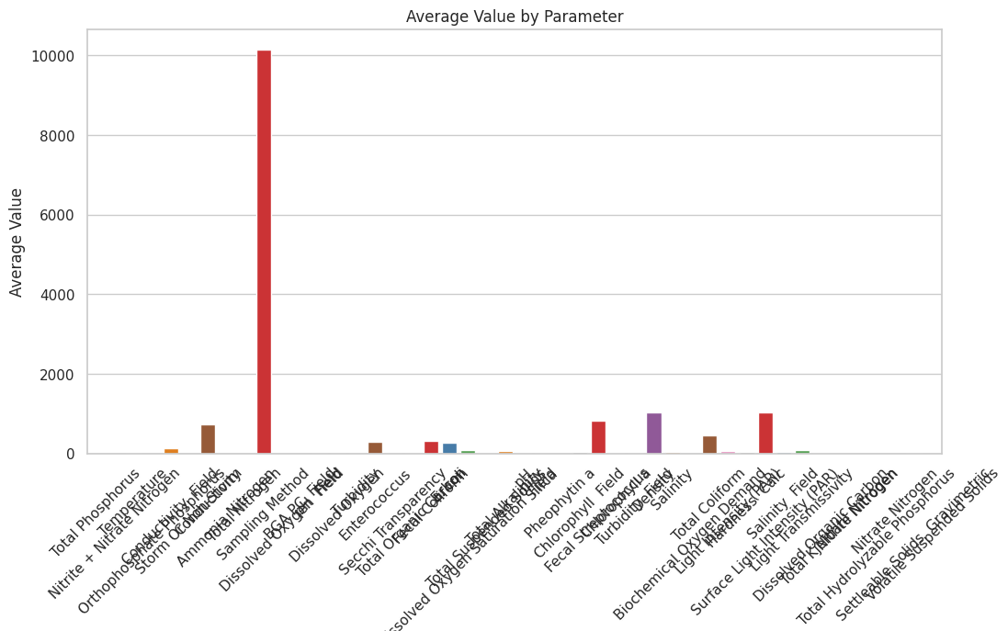
Result

Slide 9
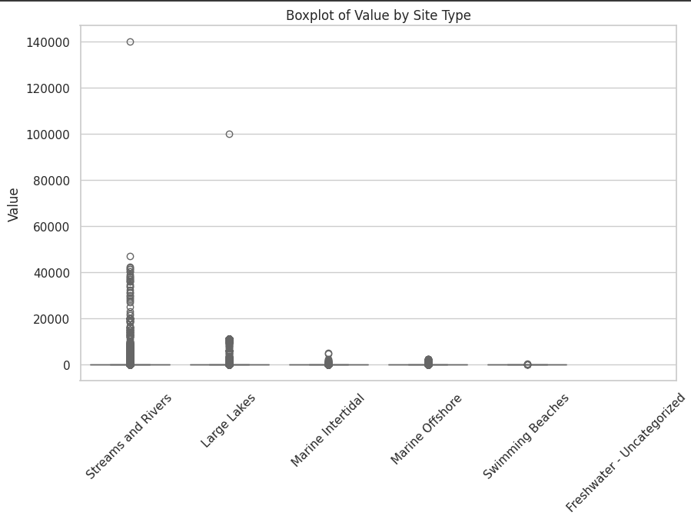
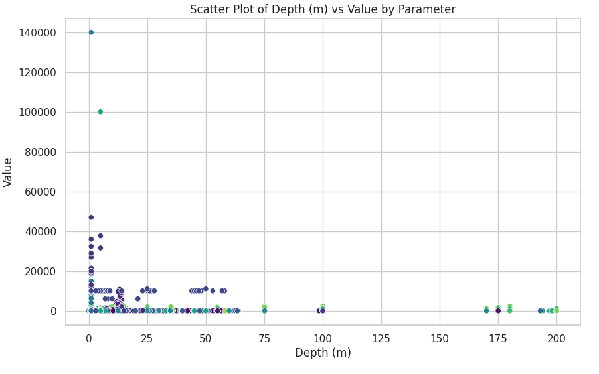
Result

Slide 10
Conclusion
Data visualization techniques act as a bridge between raw data and actionable insights. Here's how they effectively wrap up the analysis:
Condensed Knowledge:These findings underscore the need for targeted mitigation strategies to address specific sources of contamination. Regular monitoring and robust regulatory frameworks are essential to safeguard water quality. The Analysis recommendations for improving water quality include enhanced treatment of industrial and agricultural effluents, stricter enforcement of pollution control regulations, and the implementation of sustainable land-use practices. By addressing these issues, we can ensure the long-term health and sustainability of Water, protecting it for future generations and maintaining its role as a critical resource for both human and ecological communities.

Slide 11
Thank You

